Slide 1
Content of the presentation:
International greeting
Introduction of
the Czech Republic
city of Hradec Králové
University of Hradec Králové
Multiculturalism – Role of the IRO at the University of Hradec Králové
International ambassadors at UHK
Quiz for international teams or individuals

Slide 2


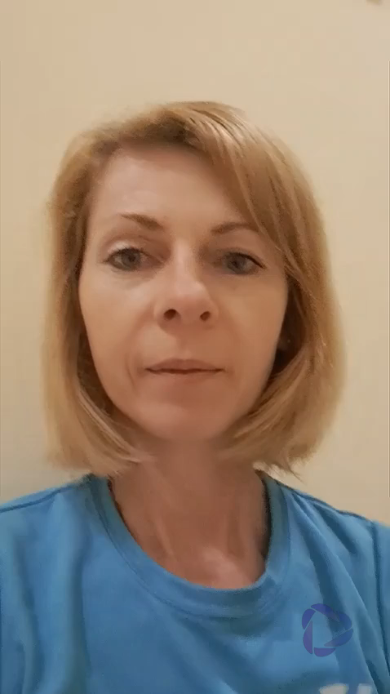
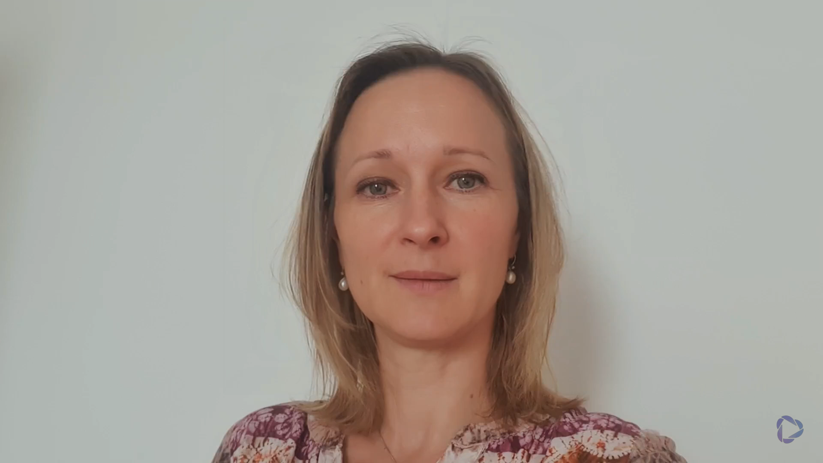
International Greeting

